Slide 1


Slide 2
Cultivating Careers: Experiences as a Technical Artist
Natalie Burke
Lead Technical Artist
Unity Technologies
#GHC19
Notes:
Welcome everyone

Slide 3
Summary
What is Technical Art?
Why is it an important and growing field?
Industry Examples
Tips for becoming a Technical Artist
Looking to the future
#GHC19
Notes:
What we will cover

Slide 4
What is Technical Art?
#GHC19
Notes:
Engage the audience
Q:
First any one in this room a technical artist?
Who knows a technical artist or works with a technical artist?
Anyone have no idea what a technical artist is?
If you ask a technical artist “what do you do” each one may give you a totally different answer.

Slide 5
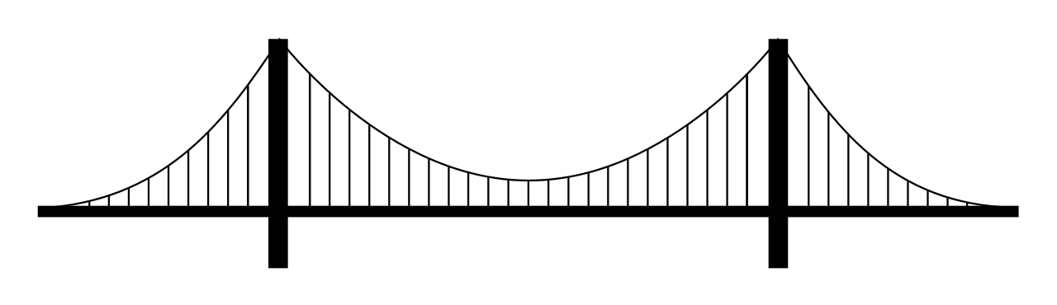
Engineering
Technical Art
Art
“What do you do?”
#GHC19
Notes:
Taking video game development as an example:
Two of the fields required to develop a video game are art and engineering
They are very distinct but important fields and they attract different types of people with different strengths, skills and interests
They grow divided and isolated in production
naturally a bridge will form between them – it has to, or the product will never be finished
artists becoming more technical, engineers becoming more artistic
These individuals are what today we refer to as technical art, and since it was a position that only recently has been given a title and formed organically every technical artist may give you a different answer to “what do you do?

Slide 6

Technical Artists
Individuals who utilize art, math, and technology in their work.
Tool development
Shading
Lighting
Procedural Content Creation
Visual Effects
Animation
Simulation
#GHC19
Notes:
If I have to encapsulate what all technical artists “do”
it would simply be “individuals who utilize art, math, and technology in their work”
Technical art is an umbrella term for many different jobs

Slide 7
Technical Artists
Create art assets that require technical expertise
Multiply artist efficiency and productivity through tools and pipeline development
Facilitate communication by translating between the languages of art and engineering
#GHC19
Notes:
How do they utilize math and art?
It varies, but generally they create technical challenging content
Build tools and develop content pipelines to multiply artist efficiency
Facilitate communication between the engineering and art departments

Slide 8
Jobs titles
General Technical Artist
Tools and pipeline Technical Artist
Character Technical Artist
Rigging Technical Artist
Technical Animator
Environment Technical Artist
Lighting (technical) Artist
Shading (technical) Artist
FX (technical) Artist
Simulation Technical Artist
Mocap Artist
Skills
Python programming
C# programming
C++ programming
Rigging
Shader writing
Modeling
Animation
Procedural content creation
Foundational art skills
Lighting
Material/surface development
Pipeline creation
Photogrammetry
Physics
Communication skills
Technical writing skills
Leadership skills
Software expertise
Maya
3DS Max
Photoshop
Substance Designer and Painter
Unity
Unreal Engine
Visual Studio
Marvelous Designer
ZBrush
Motion Builder
Blade
Houdini
SpeedTree
After Effects
#GHC19
Notes:
And to do those things they have many different skills and job titles
This slide shows various skills and software expertise from technical art job openings
“technical artist” means a lot and they “do” a lot

Slide 9
Natalie Burke
Technical Artist
What do I do?
#GHC19
Notes:
Take a specific example, me

Slide 10

Natalie Burke
Technical Artist
Lead a team of technical artists with diverse skills and expertise to design workflows for content creators and non-technical users for a large variety of purposes
Develop tools to streamline content creation and remove technical hurdles
Collaborate closely with engineering, UX design, and other Technical Artists
Contribute to documentation, training material, presentations, and demos to increase the accessibility of new features
#GHC19
Notes:
Today I am lead technical artist at Unity.
Unity builds software people use to make interactive media.
Games, education, AEC, ATM, MAE, general application development
I work on the graphics team to ensure new tools and features can be used by artists and solve the correct problems
Day to day
I lead a team of TAs with diverse skills
Develop tools, collaborate, contribute to training and presentations

Slide 11
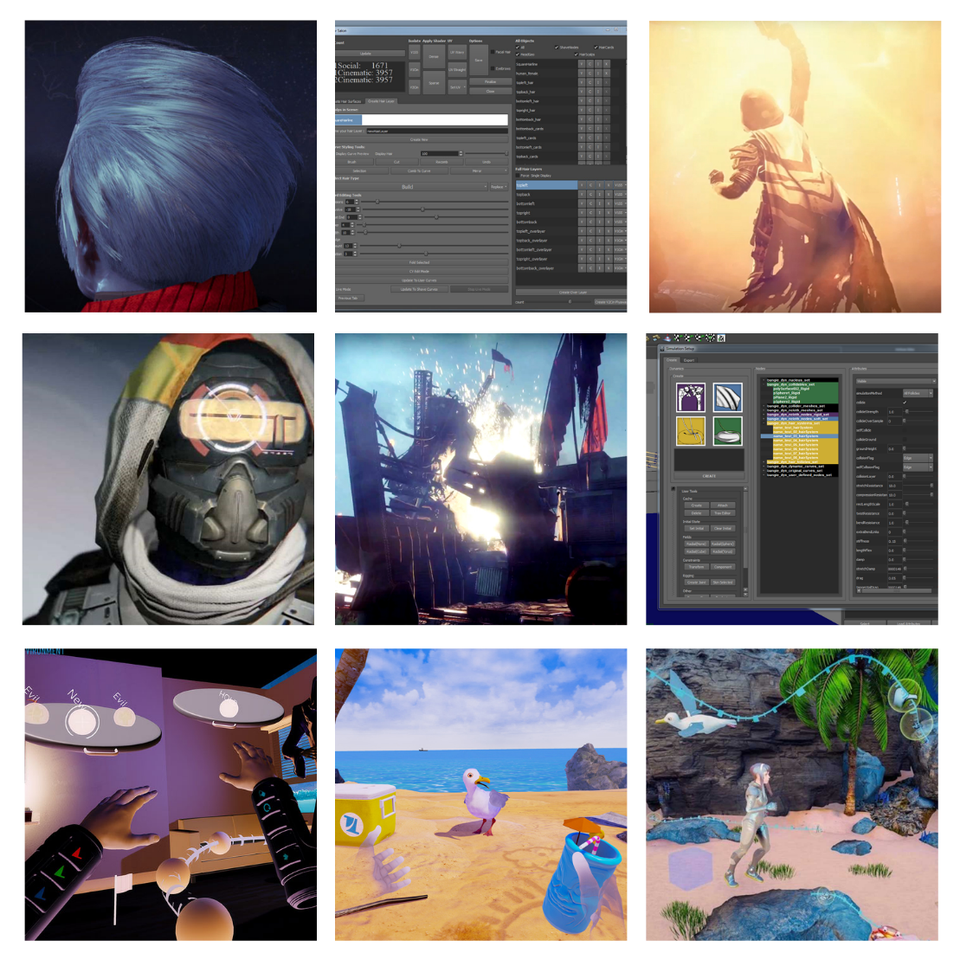
Experience:
Lead Technical Artist
Unity Technologies
Technical Director
Limitless Ltd.
Technical Artist
Bungie, Inc.
-------------------------------------
Part-Time Lecturer
University of Washington
Adjunct Professor and Advisor
DigiPen Institute of Technology
#GHC19
Notes:
Before Unity
Bungie Character Technical Artists
Technical Director at VR Startup Limitless Ltd
Tools for digital hair, cloth simulation, secondary animation, destruction
Tools for VR animation
Handling technical content creation including shading, simulation, rigging, profiling and optimization
I also teach about technical art

Slide 12
Jobs titles
General Technical Artist
Tools and pipeline Technical Artist
Character Technical Artist
Rigging Technical Artist
Technical Animator
Environment Technical Artist
Lighting (technical) Artist
Shading (technical) Artist
FX (technical) Artist
Simulation Technical Artist
Mocap Artist
Skills
Python programming
C# programming
C++ programming
Rigging
Shader writing
Modeling
Animation
Procedural content creation
Foundational art skills
Lighting
Material/surface development
Pipeline creation
Photogrammetry
Physics
Communication skills
Technical writing skills
Leadership skills
Software expertise
Maya
3DS Max
Photoshop
Substance Designer and Painter
Unity
Unreal Engine
Visual Studio
Marvelous Designer
ZBrush
Motion Builder
Blade
Houdini
SpeedTree
After Effects
#GHC19
Notes:
Different roles
Different skills
Growing

Slide 13
Why is Technical Art important?
#GHC19
Notes:
Know some about what technical artist do
Why is it is important?

Slide 14
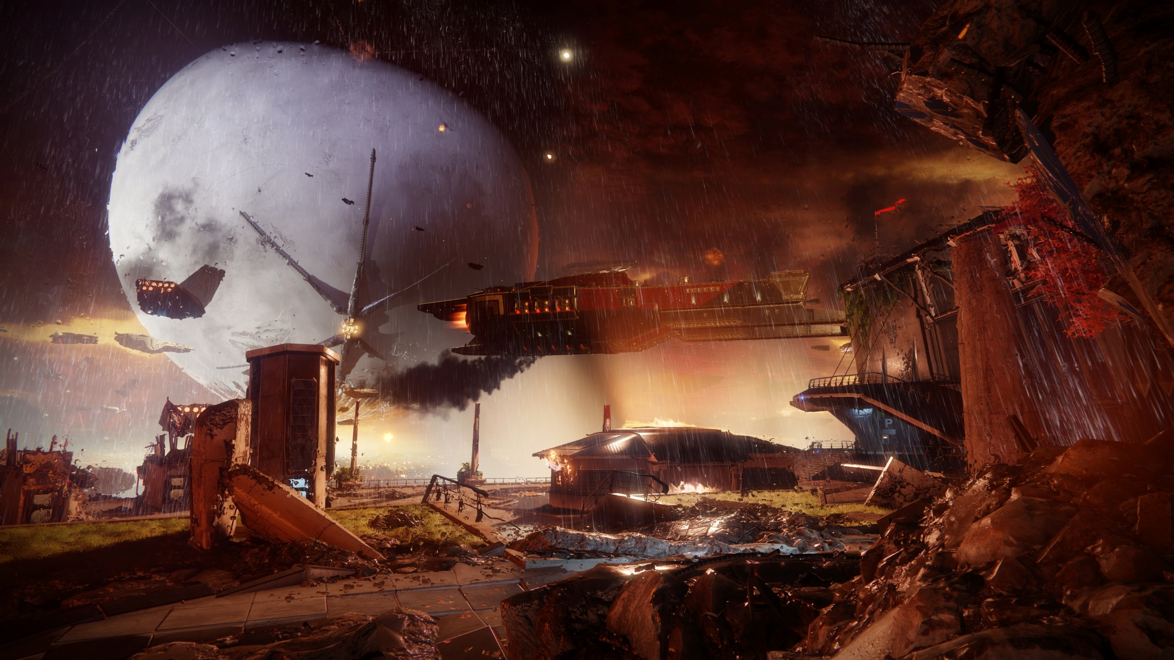


#GHC19
Notes:
Well have you seen games lately
Dynamic interactive environments

Slide 15

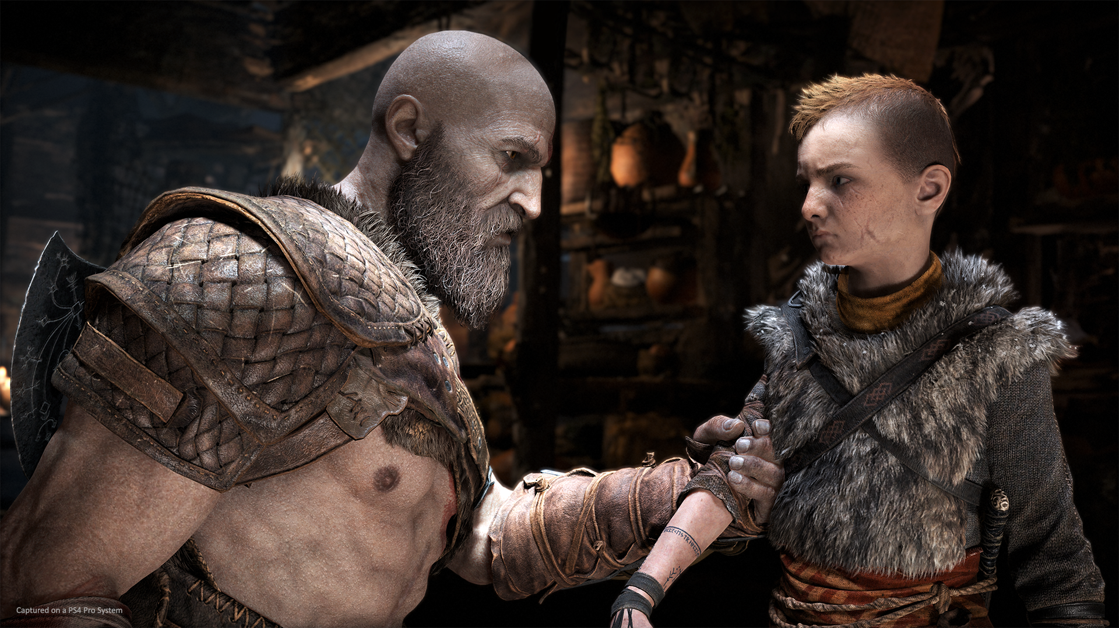

#GHC19
Notes:
High quality detailed characters

Slide 16


#GHC19
Notes:
Doing crazy animations

Slide 17
Visual expectations are high!
The fidelity of art assets has skyrocketed in recent years
The field of real time graphics has seen great leaps in technological improvements
People have more exposure and access to high quality 3D graphics
Increased expectation of high detail content that looks believable
#GHC19
Notes:
Visual expectation are high!
Graphics are becoming better
More work goes into making assets
Keep the audience feeling immersed in the universe.
Increased resolutions of televisions and computer monitors
Every small detail needs focus to keep the world feeling real (swaying tree branch, strands of hair, preventing intersections in animations with lots of secondary motion)
Happening across all media, special effects and 3D animation are prevalent in our every day life - we stop thinking about how that content is created
the line between real and computer generated is becoming blurry

Slide 18
Why is Technical Art important?
#GHC19
Notes:
Why is technical art important?

Slide 19
Art content pipelines are complicated!
#GHC19
Notes:
Content creation is complicated.
Workflows have adjusted to the increased visual expectations by becoming more sophisticated.
You have to worry about a lot more, more steps, more software programs, more individuals involved in creating a single 3D asset today

Slide 20
Idea for a character
?
Character shipped in application
#GHC19
Notes:
Example
We have an idea of a character and we want to ship that character in our game.
What are the steps and departments involved?
What does the pipeline look like

Slide 21
Idea for a character
Concepting
Narrative
Reference
Casting
Voice Acting
Engineering
Block model/White box
Facial Animation
Motion Capture
Rigging
Base mesh
Skinning
Gameplay Design
Animation
High Resolution Sculpt
Simulation
Texturing
Retargeting
Retopology
Audio
Texture Baking
Visual Effects
Lighting
Levels of Detail
Quality Assurance
Shading
Character shipped in application
Notes:
Let’s write them out
Different steps involved
Different Departments involved
What steps have dependencies on each other, who needs to talk to who?
Let’s map it out

Slide 22
Idea for a character
Concepting
Narrative
Reference
Casting
Voice Acting
Engineering
Block model/White box
Facial Animation
Motion Capture
Rigging
Base mesh
Skinning
Gameplay Design
Animation
High Resolution Sculpt
UV Creation
Simulation
Texturing
Retargeting
Retopology
Audio
Texture Baking
Visual Effects
Lighting
Levels of Detail
Quality Assurance
Shading
Character shipped in application
Notes:
As you map it out, you get a web.
This is what creating a CG character consists of.
It is not linear.
It is full of iteration and collaboration across a large array of departments of skills sets.

Slide 23
Art content pipelines are complicated!
Pipeline complexity is growing as more and more steps are added due to new technologies
The amount of expected content increases as digital worlds increase in scope to closer match reality and keep the player immersed
Successful projects require iteration of art direction and design throughout the production
Companies are increasing the amount of artists on their teams and art processes dominate production costs
#GHC19
Notes:
This complexity isn’t isolated to characters, every aspect of content creation is complex and the complexity is growing.
Consumers expect a lot of content and large digital worlds.
Good design requires iteration, so pipelines have to be flexible
The number of artists in entertainment companies is only increasing.

Slide 24
Why is Technical Art important?
#GHC19
Notes:
Which brings me to the next reason technical art is important

Slide 25
3D art content is growing
#GHC19
Notes:
3D content is growing

Slide 26

On average 2/3 of AAA and AA Game studios consists of artists
Destiny 1 shipped with 588 developers
Red Dead Redemption 2 has 3,023 employees
Ubisoft has 14,000 employees working in over 40 studios
Notes:
AAA game development budgets have skyrocket to that of blockbuster movie costs, upwards of $100M
majority of that money goes to 3D content creation
Some stats

Slide 27
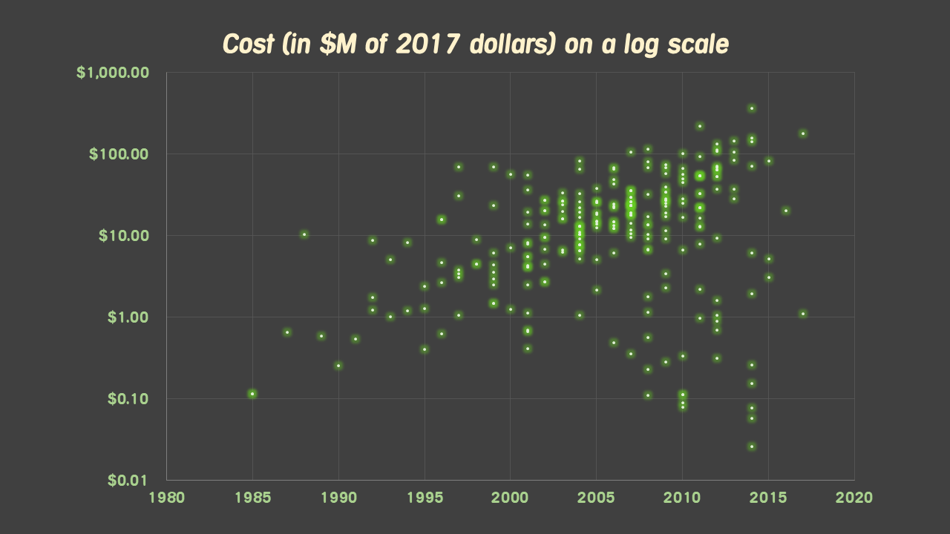
Koster, R. (2018, Jan 17). The Cost of Games. https://www.raphkoster.com/2018/01/17/the-cost-of-games/
Notes:
Let’s look at some graphs to show content growth.
Ralph Koster published a recent articles about the cost of making a game
This is a logarithmic graph
Shows the cost increase of games excluding marketing spends and adjusted for inflation – so salaries, and software.
Easy to see that the cost of making a AAA game is going up 10x every 10 years.
Much of this is on content creation

Slide 28
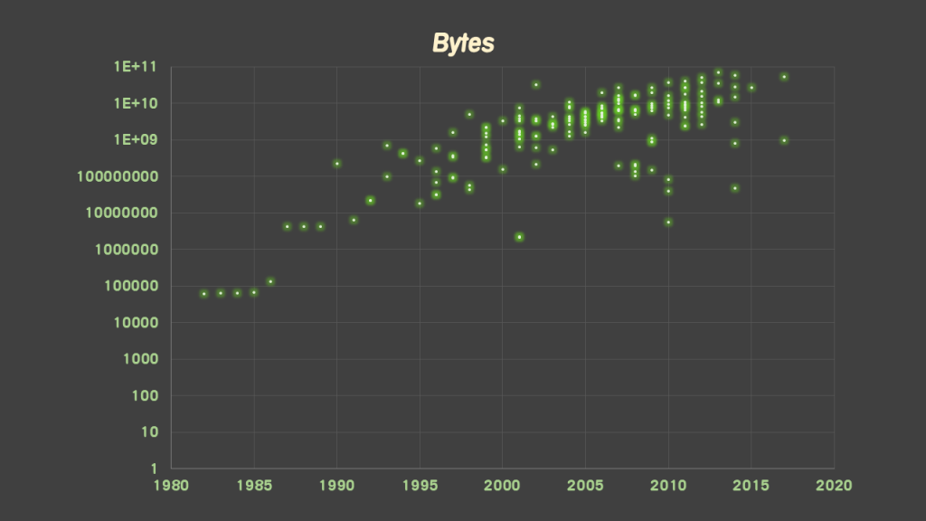
Koster, R. (2018, Jan 17). The Cost of Games. https://www.raphkoster.com/2018/01/17/the-cost-of-games/
Notes:
This graph is also logarithmic and clearly shows the amount of content is increasing

Slide 29
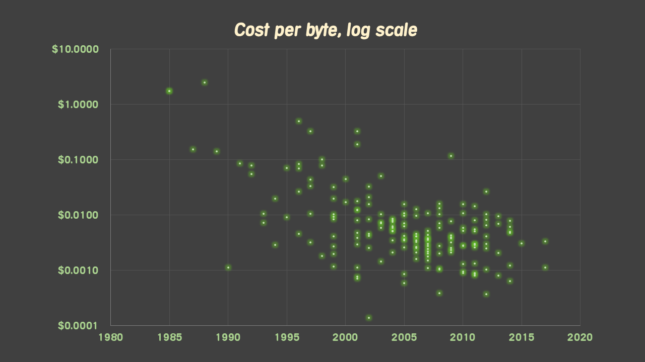
Koster, R. (2018, Jan 17). The Cost of Games. https://www.raphkoster.com/2018/01/17/the-cost-of-games/
Notes:
Let’s compare dollars to byte
How many dollars does it cost a developer to create a byte?
It has plateaued, the amount of content in games is still increasing along with the number of content creators, but it isn’t becoming cheaper to make content
This is a problem with 3D content creation.
This is a known problem

Slide 30
The future is 3D
More and more platforms available for gaming
Consumers will continue to demand more realistic 3D content and hardware will continue to improve
Virtual reality and augmented reality devices are becoming more common
Real-and-virtual combined environments are increasing with wearable technology, and content for those devices must be 3D
#GHC19
Notes:
Beyond games
Importance of 3D content is growing
Virtual reality and augmented reality devices are becoming more common
Wearable devices that combine real and virtually combined environments are moving into multiple industries
Content for those things is 3D
The necessity for lots of high quality 3D content has spilled into more industries beyond entertainment– automotive, architectural and industrial, medical, education.

Slide 31
Why is Technical Art important?
Visual expectations are high!
Art content pipelines are complicated!
3D art content is growing!
#GHC19
Notes:
So let’s revisit the earlier question:
why is technical art important
why is it growing – job openings and educational opportunities

Slide 32
Technical Artists
Create art assets that require technical expertise
Multiply artist efficiency and productivity through tools and pipeline development
Facilitate communication by translating between the languages of art and engineering
#GHC19
Notes:
Revisit what they do:

Slide 33
Technical Artists reduce production complexities!
In recent years the overarching goal of technical art has focused on solving the growing problem of art content creation complexity. Technical artists are content creation multipliers, improving the efficiency of art asset creation and reducing the costs.
#GHC19
Notes:
Technical Artists Reduce Production Complexities!
content creator multipliers
The more 3d content we need the more this job is needed
the goal of adding technical artists to a product is to decrease development costs, decrease the cost per byte
Examples

Slide 34
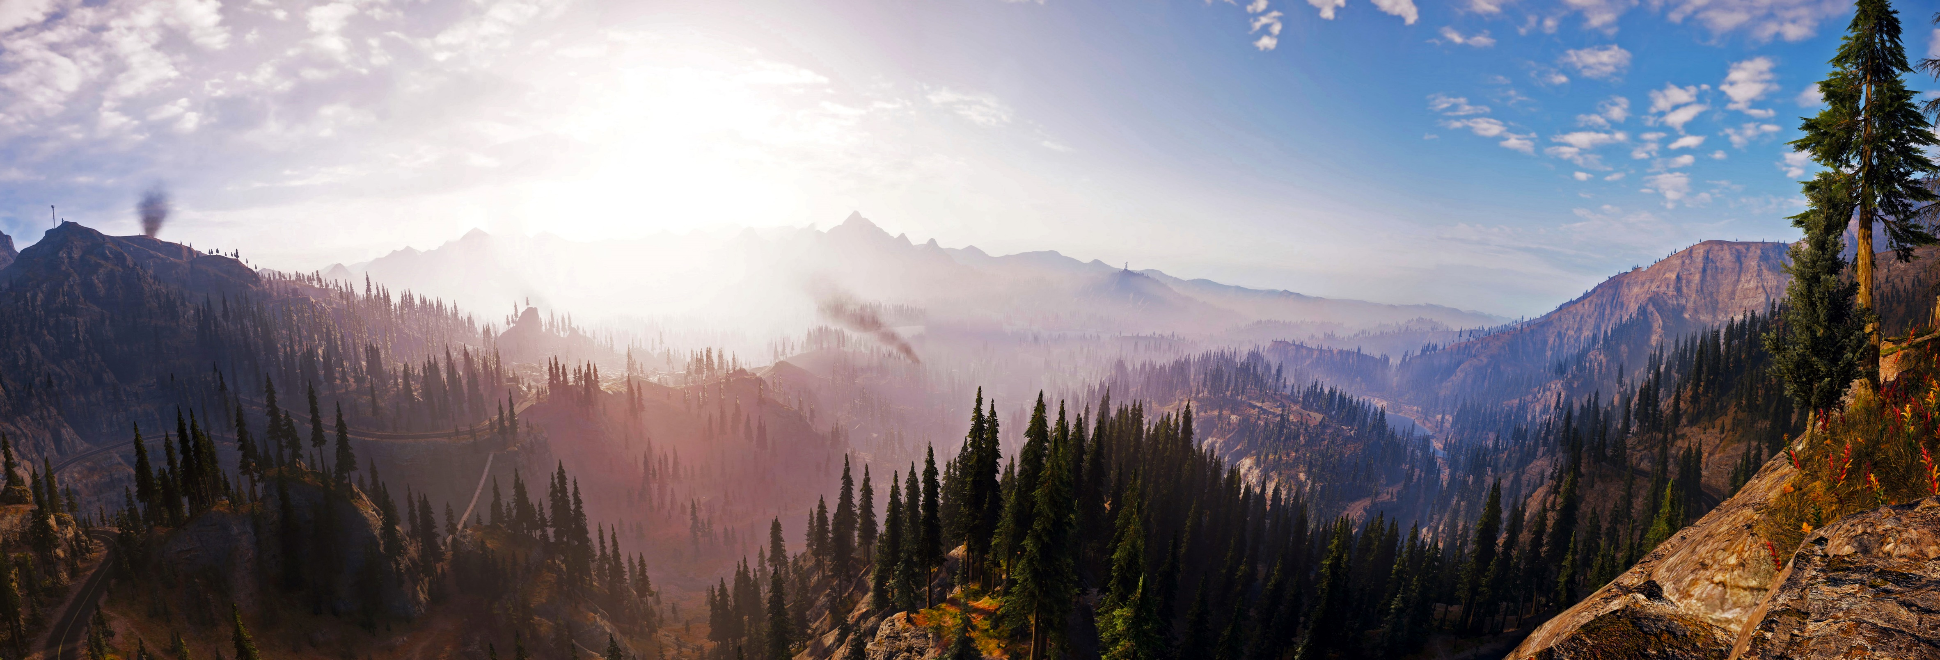

Carrier, Etienne. (2018). Procedural World Generation of 'Far Cry 5'.
#GHC19
Notes:
Far Cry 5, open world game,100square km of wilderness, players can travel wherever they want
Etienne Carrier, technical artist at Ubisoft team worked with engineers, level artists and level designers to create advanced procedural tools
to generate biomes, texture terrain, setup freshwater networks and cliffs that look natural and allowed for continuous iteration through out production.
He has given presentations and written articles that detail his tools

Slide 35
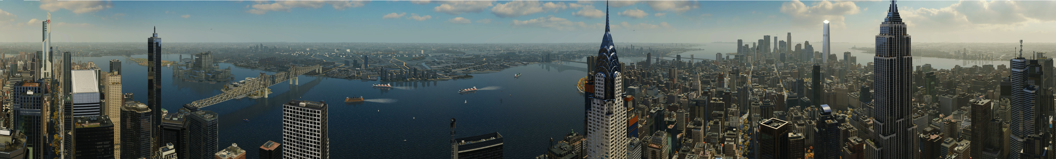

Santiago, David. (2019). Procedurally Crafting Manhattan for 'Marvel's Spider-Man‘.
Santiago, David. (2015). Procedural and Automation Techniques for Design and Production of Sunset Overdrive.
#GHC19
Notes:
'Marvel's Spider-Man' built their Manhattan using procedural tools also.
Technical artist David Santiago designed a procedural system that allowed for rapid iteration for designers and artists working in a massive world.
You can find talks and articles about his tools and techniques from this game, as well as the procedural work he did on another game, Sunset Overdrive

Slide 36


#GHC19
Notes:
Content density isn’t isolated to environments.
Bungie’s Destiny has many characters. Gameplay has a focus on player customization.
Requires many models and animations for all the players and gear.
Also customization for faces and hair.
Technical artist built and supported roughly 35 unique specialized tools for character artists, animators, cinematics and rigging teams.
Multiple talks exist about the tools and pipeline work done to create high quality visuals efficiently

Slide 37
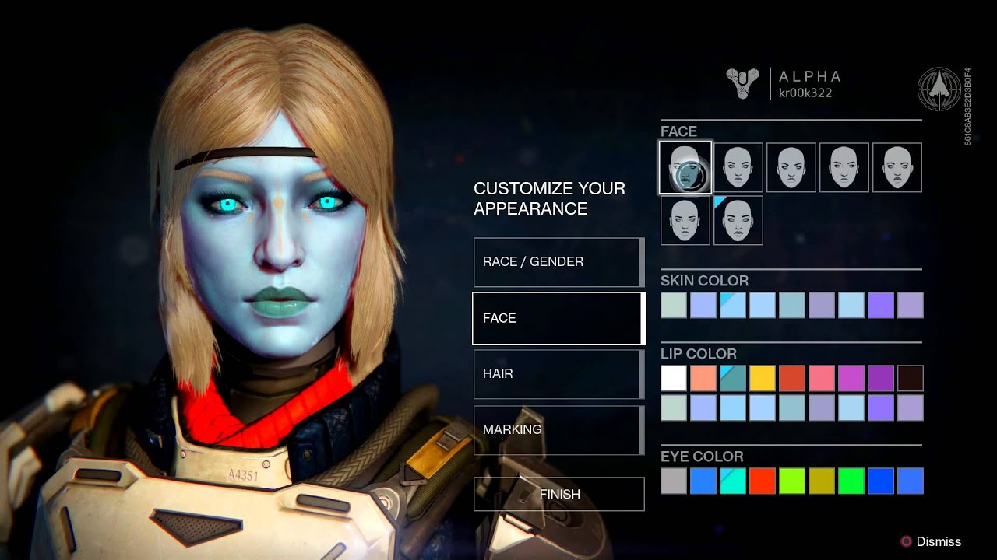
#GHC19
Notes:
Content density isn’t isolated to environments.
Bungie’s Destiny has many characters. Gameplay has a focus on player customization.
Requires many models and animations for all the players and gear.
Also customization for faces and hair.
Technical artist built and supported roughly 35 unique specialized tools for character artists, animators, cinematics and rigging teams.
Multiple talks exist about the tools and pipeline work done to create high quality visuals efficiently

Slide 38
Hunt, David., Soderlind, Forrest. (2015). Tools-Based Rigging in Bungie's Destiny.
Burke, Natalie. (2016). Animating With Math.
Shepherd, Scott. (2014). Building Customizable Characters for Bungie's Destiny.
Lico, Richard. (2014). Designing the Bungie Animation Workflow.
Sanocki, Tom., Jones, Jason Garris. (2014). Face Animation Retargeting in Destiny.
Burke, Natalie. (2014). Hair in Destiny.
#GHC19
Notes:
Content density isn’t isolated to environments.
Bungie’s Destiny has many characters. Gameplay has a focus on player customization.
Requires many models and animations for all the players and gear.
Also customization for faces and hair.
Technical artist built and supported roughly 35 unique specialized tools for character artists, animators, cinematics and rigging teams.
Multiple talks exist about the tools and pipeline work done to create high quality visuals efficiently

Slide 39
Technical Artists reduce production complexities!
Embrace procedural content creation: build tools and workflows that facilitate procedural content generation and hand authored assets while enabling fast iteration speeds between multiple departments
Streamline complicated pipelines: build pipelines that are scalable, future-proof, and keep all areas of production unblocked
Automate tedious tasks: batch repetitive processes
#GHC19
Notes:
I could continue to show examples
all major game studios have growing technical art teams that are essential to the production.
Tech artists have many key roles
Building procedural systems
Building tools and pipelines
Automated tedious tasks
Reducing production bottlenecks
Keep artists making art

Slide 40
Technical Art beyond games
#GHC19
Notes:
And technical artists are not isolated to games today

Slide 41
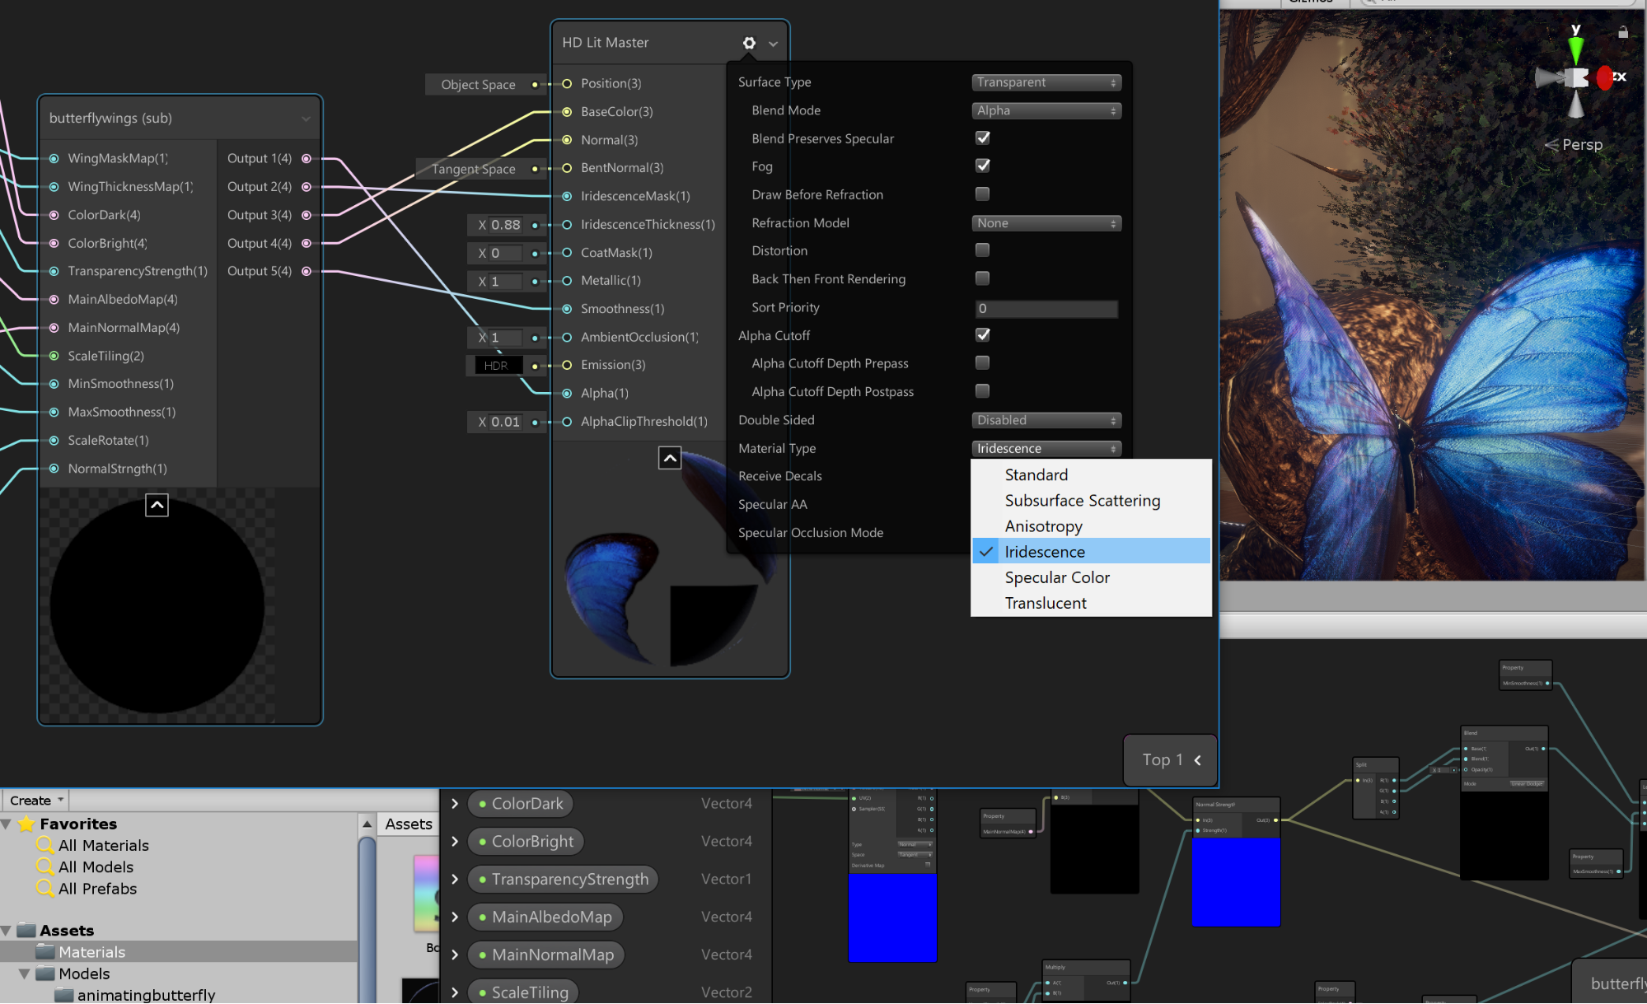
#GHC19
Notes:
Software companies that create the programs used by games and entertainment have technical artists
Myself, I have moved from games to software
Unity’s shader graph, one of the first new features I worked on at Unity, the staff of this feature is almost 50% technical art.
Since starting at Unity the tech art team has grown substantially.
And that’s not just at Unity, other similar software companies have growing technical art staffs: Epic, Autodesk, Adobe

Slide 42





#GHC19
Notes:
We now see Technical Artist at major retail companies.
The increase of AR applications

Slide 43
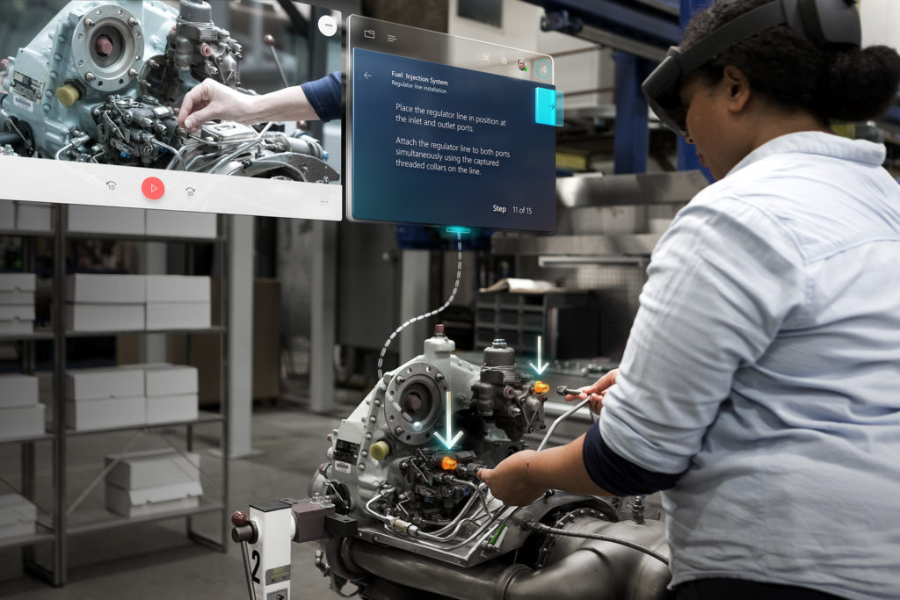

#GHC19
Notes:
Increase in wearable technology.
Mixed reality tools are growing in popularity for professional training.
These software programs have technical artists on staff.

Slide 44
Technical art job markets
Entertainment
  Games
  Film
  Interactive media
  Advertisement
Automotive
  Simulation
  Autonomous vehicles
  Production
  Advertisement
Education
  Job training
Architectural/ Industrial/ Manufacturing
  Simulation
  Production
  Training
  Advertisement
Medical
  Visualization
  Training
  Research
  Psychology/ Behavioral sciences
3D Simulation for military, police, firefighting
#GHC19
Notes:
The problem set technical artist tackle isn’t isolated to just games and film anymore.
Many industries have already discovered the benefits of hiring technical artists
I predict only more of a demand for technical art

Slide 45
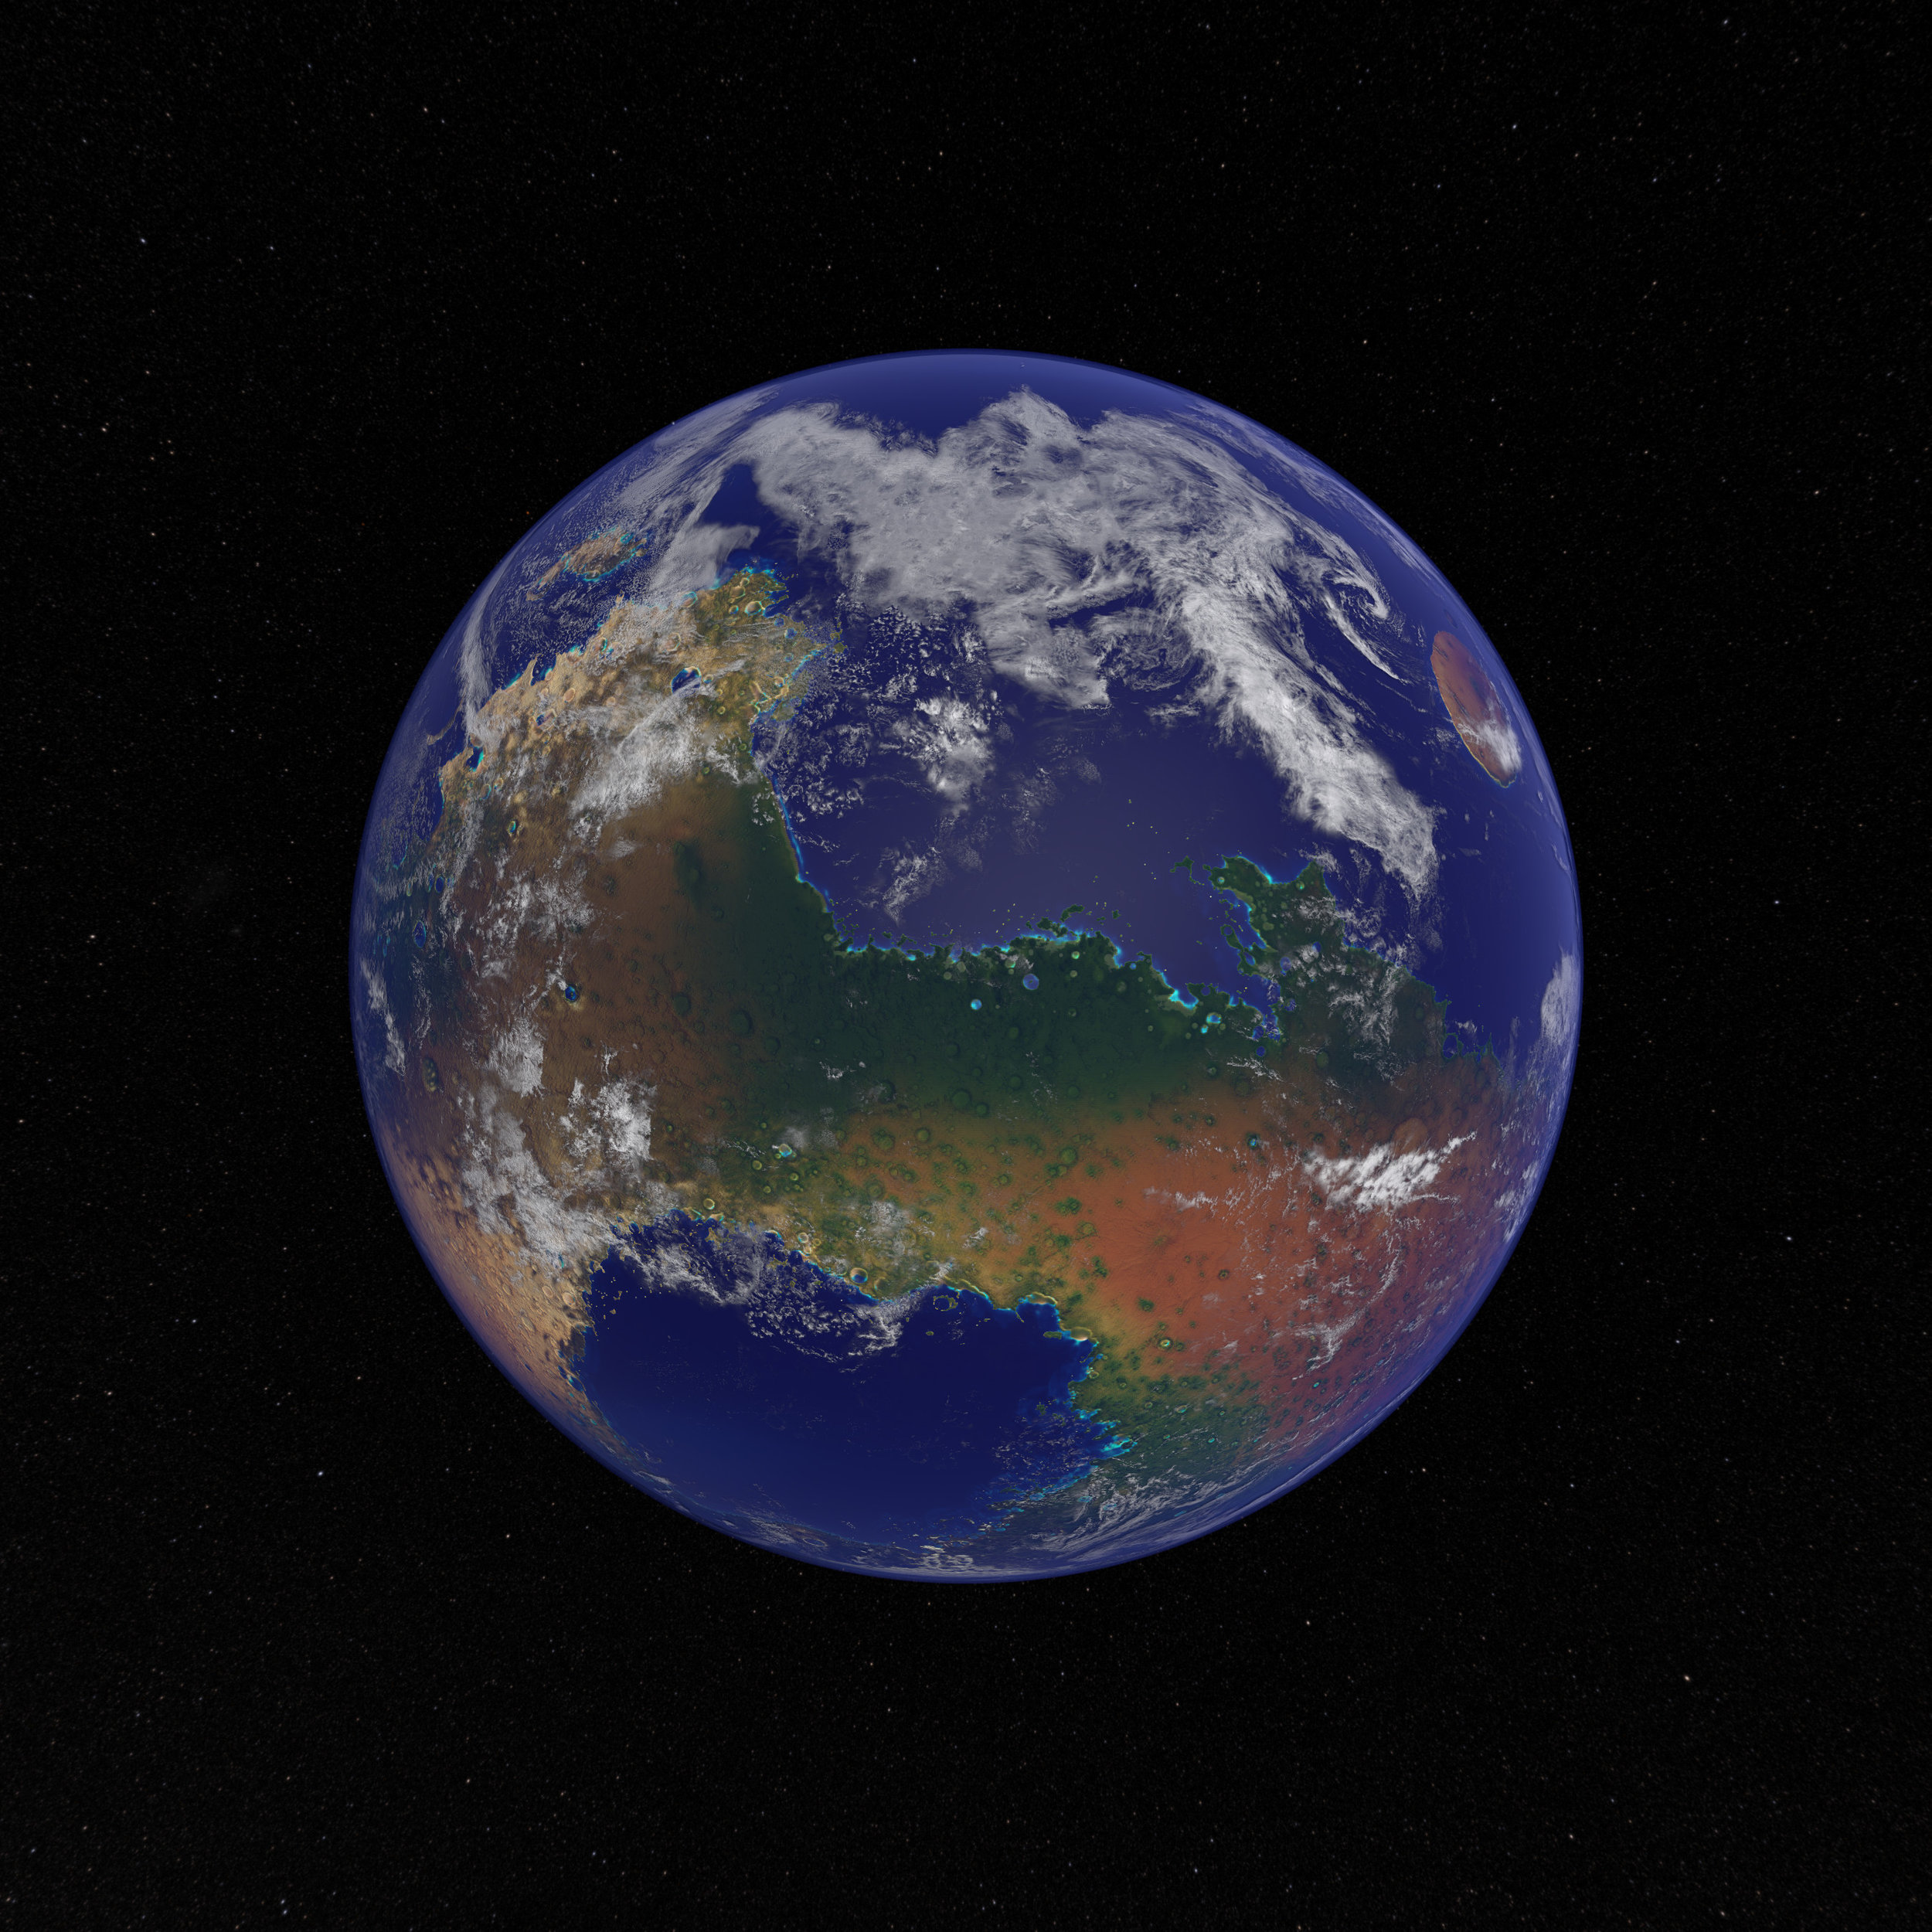
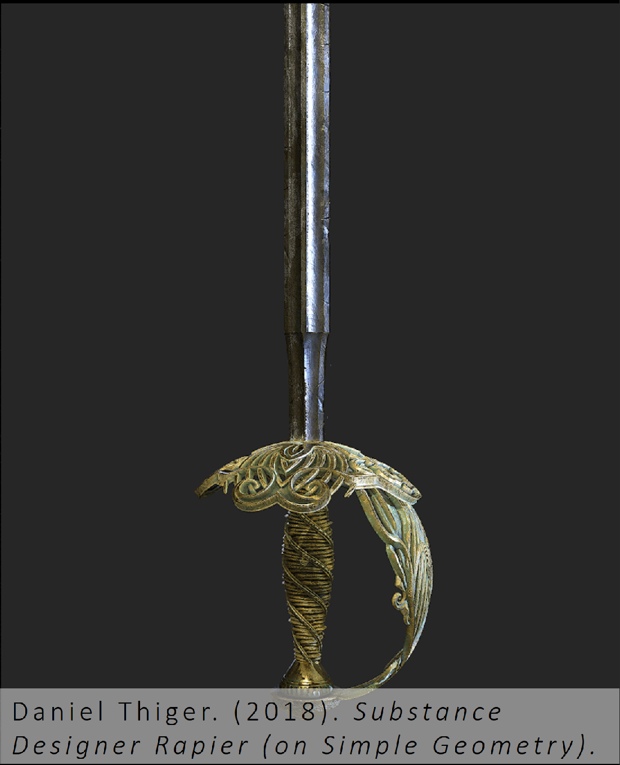
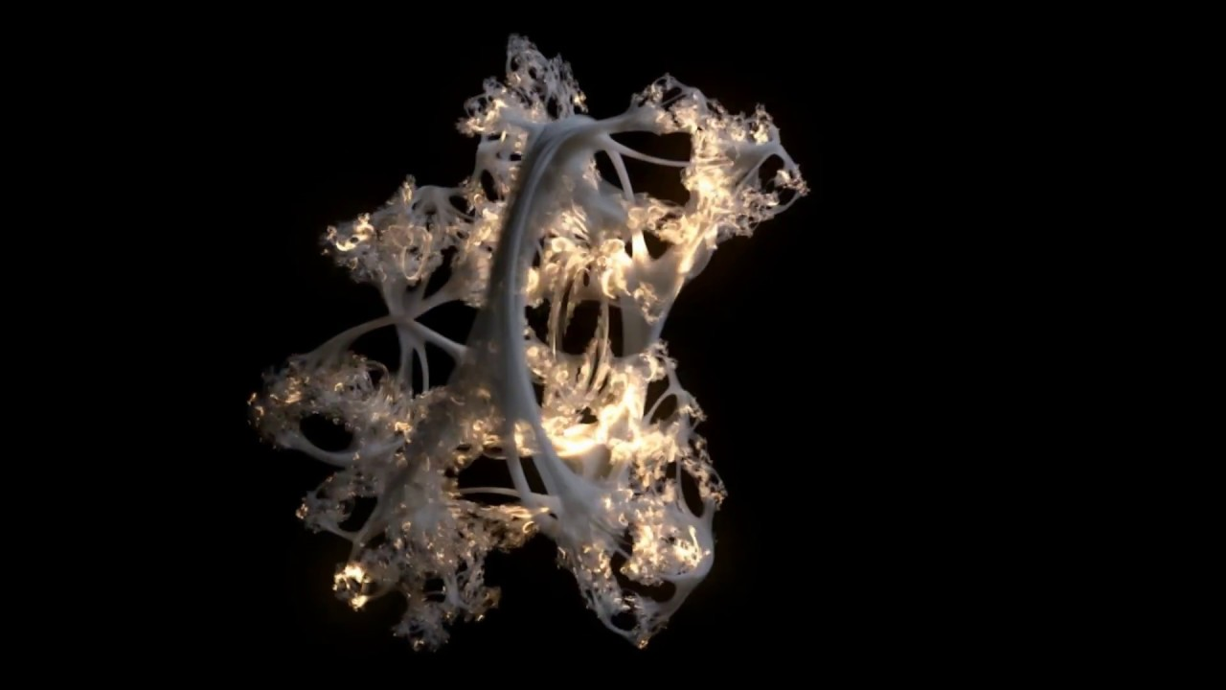

Weili, Shi. (2019). Terra Mars.
Daniel Thiger. (2018). Substance
Designer Rapier (on Simple Geometry).
#GHC19
Notes:
Everything I just mentioned was focused around tooling and pipeline development
There are also technical artists that create technical art
These are also important and also essential to many fields as they are innovators

Slide 46
Why become a Technical Artist?
#GHC19
Notes:
Career track
Why be a tech artist

Slide 47
Benefits of being a Technical Artist
Lots of flexibility in what you do
Different work available in many industries
Tons of job openings
#GHC19
Notes:
Lot of flexibility of what you can do
Lots of industries.
Still a young field, lots of jobs

Slide 48
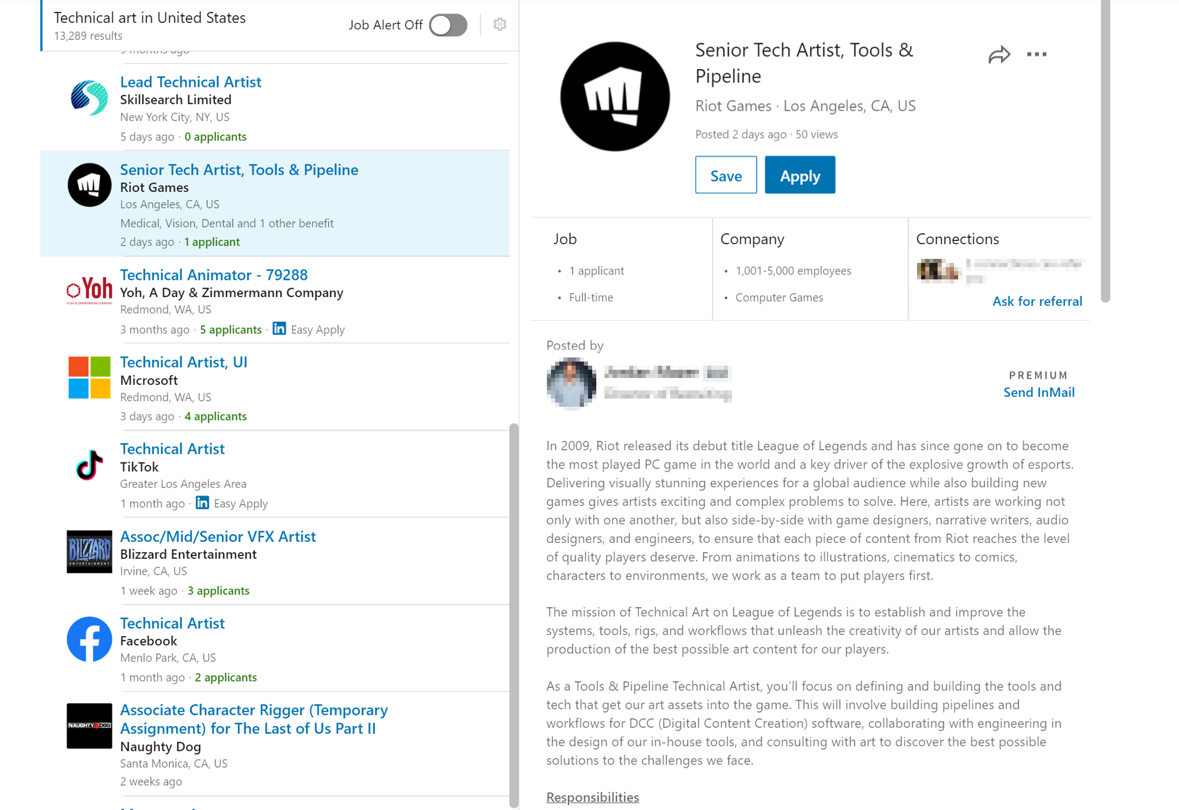
Notes:
Seriously, lots of jobs, google it

Slide 49
How do you become a Technical Artist?
Love math and art
Love solving puzzles
Excited by new technology
Lifelong learner
#GHC19
Notes:
So how do you become an tech artist?
What do you love?

Slide 50
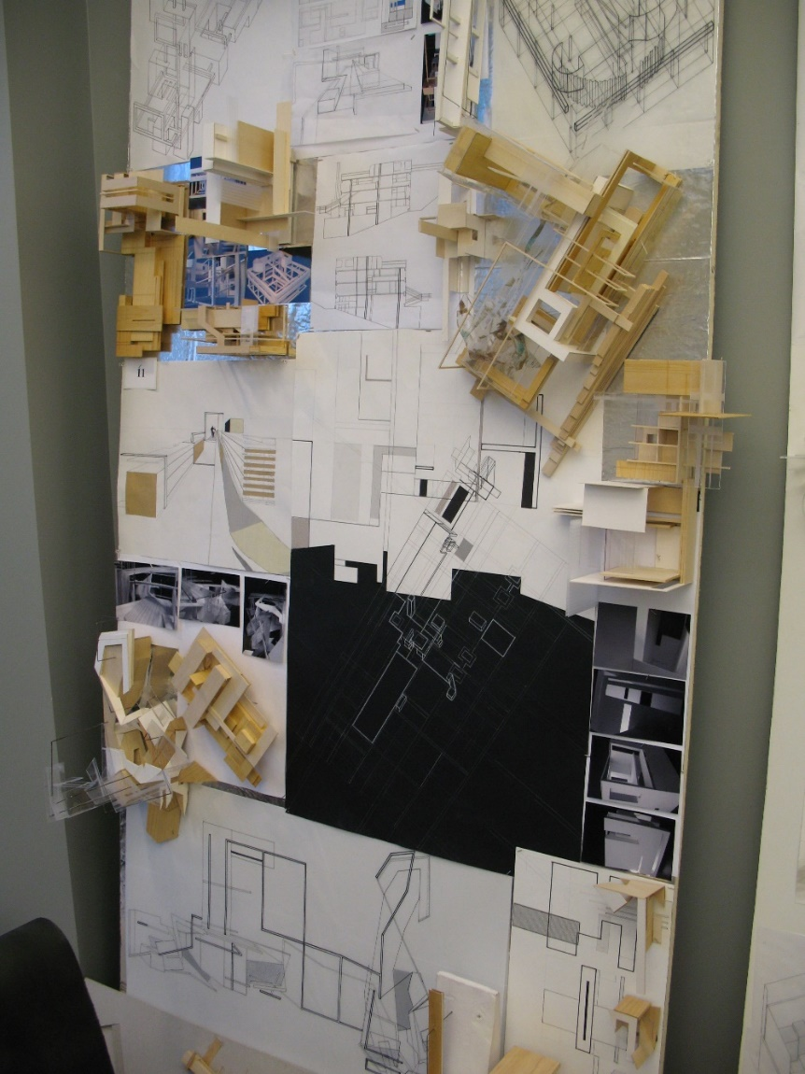
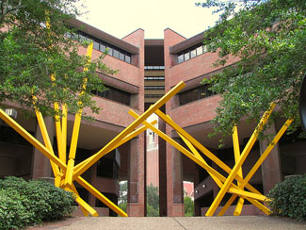

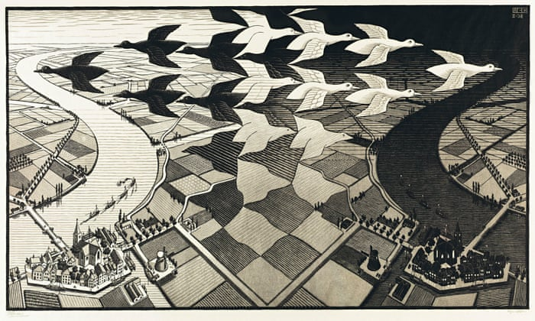
How did I become a Technical Artist?
#GHC19
Notes:
My story

Slide 51
Becoming a Technical Artist today
Educational opportunities are popping up everywhere:
  FIEA
  University of Utah
  Carnegie Mellon
#GHC19
Notes:
Today there are more straight forward paths.
Actual technical art tracks and courses available at Universities.

Slide 52



Notes:
Tailored track just for technical art.
Masters in technical art
Individual courses in technical
Demand for educators in the area of tech art also

Slide 53
Becoming a Technical Artist today
Educational opportunities are popping up everywhere:
  FIEA
  University of Utah
  Carnegie Mellon
Design your own path:
  Join game clubs
  Help out indie projects
  Make your own game or app
Build a strong portfolio:
  Build tools to speed up content creation
  Showcase programming skills
  Showcase art skills or an appreciation for art
  Knowledge and experience using 3D content creation tools
  Create art projects utilizing math and technology
#GHC19
Notes:
Opportunities outside of school,
accessibility of game engines,
make your own game
Clubs and associations everywhere
The purpose is to build a portfolio.
Technical art is still new enough that a direct major is still not an expectation for employers.
Employers want to foremost see a portfolio.
Showcasing a range of programming and art skill
experience with different DCCs and experience working on projects with other artists

Slide 54
How do you hire a Technical Artist?
#GHC19
Notes:
Hiring a technical artist, what should you look for?
Or for students and job seekers, what are people hiring technical artists looking for

Slide 55
How do you hire a Technical Artist?
Look at the portfolio!
  Look for experience being a multiplier – automation, pipeline streamlining, procedural content creation
  Experience supporting artists – collaboration, leadership, tailored tool development
  Look for a unique project – innovation
  Look for side projects and hobbies
Does their personal mission fit what you are looking for?
  Do their interests align with the role?
  Does their past work cover or extend to the requirements of this role, if not, are they interested and able to grow into the requirements?
  It can be difficult to find a Technical Artist with experience doing exactly what you need for this role
#GHC19
Notes:
It’s all about that portfolio
examples of that person being a multiplier
looking for innovation, can they bring ideas that are unique
do they actually fit the role – remember technical art is an umbrella term, all are different, as well as their skills and interest
Do they actually align to the job, will they enjoy it
Unfortunately technical artists are still unicorns.
Demand doesn’t match amount

Slide 56

How do you hire a Technical Artist?
Look at the portfolio!
  Look for experience being a multiplier – automation, pipeline streamlining, procedural content creation
  Experience supporting artists – collaboration, leadership, tailored tool development
  Look for a unique project – innovation
  Look for side projects and hobbies
Does their personal mission fit what you are looking for?
  Do their interests align with the role?
  Does their past work cover or extend to the requirements of this role, if not, are they interested and able to grow into the requirements?
  It can be difficult to find a Technical Artist with experience doing exactly what you need for this role
#GHC19
Notes:
It’s all about that portfolio
examples of that person being a multiplier
looking for innovation, can they bring ideas that are unique
do they actually fit the role – remember technical art is an umbrella term, all are different, as well as their skills and interest
Do they actually align to the job, will they enjoy it
Unfortunately technical artists are still unicorns.
Demand doesn’t match amount

Slide 57
How to increase the amount of Technical Artists?
#GHC19
Notes:
How to increase technical artists

Slide 58
Integration of art and technology in education must increase!
A
STE
M
#GHC19
Notes:
Must integrate art and technology in education
stop keeping this two departments separated.
STEM is going to become STEAM – arts in technology is increasing and growing and we, as scientists, innovators educators, must embrace it moving forward

Slide 59
Looking to the future
Increased importance improving content creation workflows as more and more digital media moves to 3D
Interdisciplinary fields are going to grow
Increased diversity of roles in software development
TECHNICAL ARTISTS EVERYWHERE! :)
#GHC19
Notes:
Looking to the future of technology
3D content will be in everything, interactive media will be in everything
Interdisciplinary staffs will grow
Technical artists will be everywhere

Slide 60




Please remember to complete the session survey in the mobile app.
THANK YOU!
natalieburke@natbird.com
natbird.com
linkedin.com/in/natalie-burke-87340330
#GHC19
Notes:
Thank you

